Slide 1
Why?
Part 2
Why we do not have
a church kitchen

Slide 2
BIBLE AUTHORITY
A CHURCH’S BANK ACCOUNT AIDS IN FULFILLING THE COMMAND TO STORE UP
(1 COR. 16:2)

Slide 3
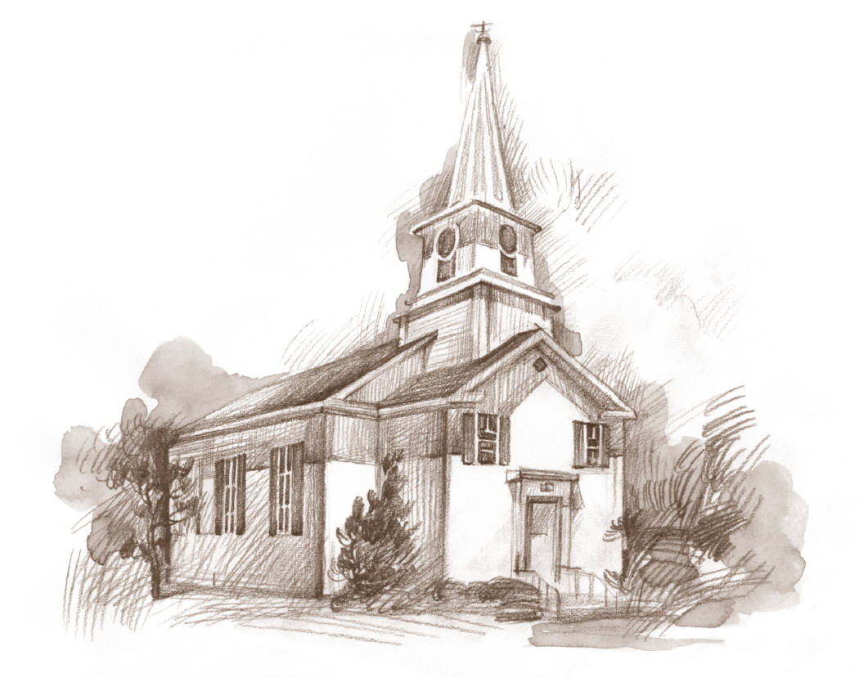
A CHURCH’S BUILDING
AIDS IN THE COMMAND TO ASSEMBLE
(HEB. 10:25; 1 COR. 11:18)

Slide 4
WHAT BIBLE COMMAND DOES A “CHURCH KITCHEN” AID IN FULFILLING?
??? SCRIPTURE ???

Slide 5
WHY NOT?
CHURCH GYMS?
CHURCH HOSPITALS?
CHURCH MOVIE THEATERS?
CHURCH GROCERY STORES?
WHERE DO WE DRAW THE LINE?

Slide 6
THE KINGDOM OF GOD
“For the kingdom of God is not eating and drinking, but righteousness and peace and joy in the Holy Spirit.”
(ROM. 14:17)
“EATING & DRINKING” HAVE AS MUCH TO DO WITH THE KINGDOM OF GOD AS THEY DO WITH “RIGHTEOUSNESS,” “PEACE” & “JOY” IN THE SPIRIT!

Slide 7
YET
THE DENOMINATIONAL WORLD’S EMPHASIS IS ON “EATING AND DRINKING!”
Ex 32:6, “Then they rose early on the next day, offered burnt offerings, and brought peace offerings; and the people sat down to eat and drink, and rose up to play.”

Slide 8
Why we do not have
a church kitchen
I. No Bible Authority For it
II. Not A Work Of The Church

Slide 9
Work of the Local Church
Evangelism (1 Tim. 3:15; Eph. 4:15)
Edification (Eph. 4:16)
Limited Benevolence
(1 Tim. 5:16; Acts 11:27-30)
Social / Recreation
(?? Where is the passage ??)

Slide 10
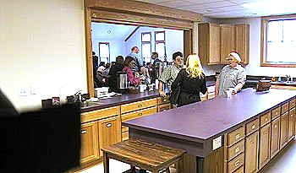
A Church Kitchen
Is not the work of Evangelism
Is Not the work of Edification
Is Not the work of Benevolence

Slide 11
Why we do not have
a church kitchen
I. No Bible Authority For it
II. Not A Work Of The Church
III. The Church Is Not A Social Order / The Gospel Is Not A Social Gospel

Slide 12


Not a Social Order
Not a Social Gospel
The Church Is Not
A Social Order
Rom. 14:17
John 18:36
1 Pet. 2:5
The Gospel Is Not
A Social Gospel
John 6:26-27
Rom. 1:16-17
1 Cor. 1:18, 21;
2:2-5

Slide 13
Why we do not have
a church kitchen
I. No Bible Authority For it
II. Not A Work Of The Church
III. The Church Is Not A Social Order / The Gospel Is Not A Social Gospel
IV. Individual Liberties Are Not Church Liberties

Slide 14
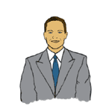
A Difference In The
Individual & The Church
1 Tim. 5:16
If any man or woman that believeth have widows, let them relieve them, and let not the church be charged; that it may relieve them that are widows indeed.

Slide 15
“Christian” Acts 11:26 1 Pet. 4:16 |  | Church of Christ Rom. 16:16
Own Widows 1 Tim. 5:16 |  | Widows Indeed 1 Tim. 5:16
Buy & Sell Jas 4:13 |  | Free will offering 1 Cor. 16:1-2
Name
Work
Finances

Slide 16
MATTHEW 25:34-36
when a saint is in need of food | feed him | CHURCH OF CHRIST GROCERY??
when a saint is in need of water | give him drink | CHURCH OF CHRIST WATER BOTTLING CO.??
when a saint is a stranger | befriend him | CHURCH OF CHRIST HOTEL CHAIN??
when a saint is naked | clothe him | CHURCH OF CHRIST CLOTHING STORE??

Slide 17

Common Meals – Individual Matters
1 Cor. 11
20 Therefore when you come together in one place, it is not to eat the Lord’s Supper.
21 For in eating, each one takes his own supper ahead of others; and one is hungry and another is drunk.
22 What! Do you not have houses to eat and drink in? Or do you despise the church of God and shame those who have nothing? What shall I say to you? Shall I praise you in this? I do not praise you.
More than an abuse of the Lord’s Supper!

Slide 18
Incidental Matters
While At Building
Planned & Sponsored
By the Church
Talk about politics
Deliver a sold item
Ask medical advice
Eating on property
Political rally
Church in business
Church hospital / clinic
Church kitchen / dinner

Slide 19
Why we do not have
a church kitchen
I. No Bible Authority For it
II. Not A Work Of The Church
III. The Church Is Not A Social Order / The Gospel Is Not A Social Gospel
IV. Individual Liberties & Responsibilities Are Not Church Liberties & Respon.

